Slide 1
Content marketing
strategy template.
yellow.com.au

Slide 2
Content marketing
strategy.
[Date: M/Y]
[Insert your logo]

Slide 3
Business Profile & Objectives.
Briefly outline the nature of your business, what products and/or services you offer and list the main objectives you hope to achieve with your content marketing.
Example:
Objectives:
To expand the business into [locations/s]
To grow our follower base on [social media platform/s]
To target a younger demographic with our [products/services]
To grow our brand’s presence online
Etc.

Slide 4
The Team.
Detail the names, job titles and roles of the staff members who are going to be working on your content marketing strategy.
Example:
Joe Bloggs
Project manager
Role: To coordinate the design and implementation of the content marketing strategy, including organising weekly WIPs and presenting progress reports.

Slide 5
The Team.
Name
Title
Name
Title
Role: Description
Role: Description
Name
Title
Name
Title
Role: Description
Role: Description

Slide 6
Current Content Assets.
List the content you already have and assess its performance, including your social media accounts. You may choose to refresh high-performing content and re-use it in your strategy.
Example:
Social media accounts
Facebook [URL]
Instagram [Profile name]
YouTube [URL]
Etc.
Other assets (e.g. photos, email newsletter, eBooks, White Papers, etc.)
10 x professional photos of recent projects
Monthly email newsletter
5 x eBooks
Etc.
Blog articles
How to get better results from your [XXX]
Top 7 tips for [XXX]
Why [XXX] is so important …
Etc.
Videos
How to fix your [XXX] in three easy steps
Watch our experts on what not to do when [XXX] happens
DIY tips for getting the most out of [XXX]
Etc.
High-performing content (include details of likes, clicks, views etc.)
How to fix your [XXX] in three easy steps: 300+ views on YouTube/255 likes on Facebook
Monthly email newsletter: averaging approx. 1100 click throughs per month
Etc.

Slide 7
Competitor Analysis.
Identify the top three competitors in your industry and/or location. List the kinds of content they produce, including their social media accounts, and its pros and cons. Identify gaps in their content that you might be able to fill.
Example: 1. Bayside Patios, Porches & Pergolas.
Content | Social Media | Content Gaps
Blog articles Before and after videos Email newsletter Etc. | Facebook Instagram YouTube Etc. | Blog articles are not location-specific Instagram could be better utilised to drive engagement High quality before and after videos/photos Etc.
Pros Good selection of blog articles responding to keyword research and seasonality Email newsletter is regular and contains useful information. | Pros Active on Facebook with 9000+ followers and good engagement on posts
Cons Videos are poor quality | Cons Facebook posts shared to Instagram but there is little engagement on the platform YouTube videos shared to Facebook, but poor quality reduces engagement.

Slide 8
Audience Profile.
Use this section to identify the key attributes of your target audience, to ensure your content is useful, engaging and relevant to your current and potential customers.
What is your audience looking for? What keywords/key phrases are they searching?
Demographics Gender, age, ethnicity, industry, job, income bracket
What type of content do they prefer? Blogs, eBooks, videos, social media posts, etc.
Psychographics Values, beliefs, habits, interests
How can we help our audience? Once you’ve identified your customers, their preferences, and their pain points, brainstorm the kinds of content you can provide to answer their questions, offer them solutions and drive engagement with your brand.
Challenges What are your audience’s pain points?
Where do they get their information? Internet, newspapers, ads, commercials, social media, etc.

Slide 9
Content Strategy.
Set out detailed descriptions of what kinds of content you are going to produce, how you’re going to produce it, where it’s going to be posted and when it’s going to be implemented.
Include a section for measurement metrics and KPIs, detailing how you’re going to assess the success or otherwise of your content.
Example on the following page.

Slide 10
Content Strategy.
[Your Business] | Content Strategy | Timeline: M/Y to M/Y
Type of content | 4 x blog posts per month | 6 x before & after videos | 8 x social media posts per month
How | Engage an SEO copywriter | Engage a videographer to produce a six before and after videos of significant projects | Set up and schedule automated social media posts. A/B test 4 x sponsored vs 4 x unsponsored.
Where | Website & social media | YouTube, website & social media | Facebook & Instagram
When | Every Tuesday | Once per month for 6 months | Tuesday & Thursday
Measurement metrics | Website: Google Analytics: views, time on page, bounce rate, etc. Number of newsletter subscriptions Social media: Likes # Shares # New follows # Comments # | YouTube: Number of views, shares, comments Website: Google Analytics: views, time on page, bounce rate, etc. Social media: Likes # Shares # New follows # Comments # | Facebook & Instagram: Page/Instagram Insights to measure: Reach, impressions, audience growth rate, engagement, ROI, etc. A/B test: As above, to measure ROI on sponsored vs unsponsored posts
KPIs | Website: X% increase in views, etc. X% increase in newsletter subs Social Media: X% increase in Likes, etc. | YouTube: X% increase in views, etc. Website: X% increase in views, etc. Social Media: X% increase in Likes, etc. | Facebook & Instagram: X% increase in reach X% increase in impressions X% increase in engagement, etc.

Slide 11
Priorities and Timeline.
Example:
Date:
Strategy document finalised
Action: Send to all stakeholders
Comments: Needs to be signed off by Joe Bloggs before sending
Date:
Action: Post 1 x blog article to Facebook and Instagram
Comments: N/A
Date:
Action:
Comments:
Date:
Action:
Comments:
Date:
Action:
Comments:
Date:
4 x blog articles finalised
Action: Upload to website
Comments: N/A
Date:
Edited videos due
Action: Review & upload to YouTube
Comments: Schedule video social posts
Date:
Action:
Comments:
Date:
Action:
Comments:

Slide 12
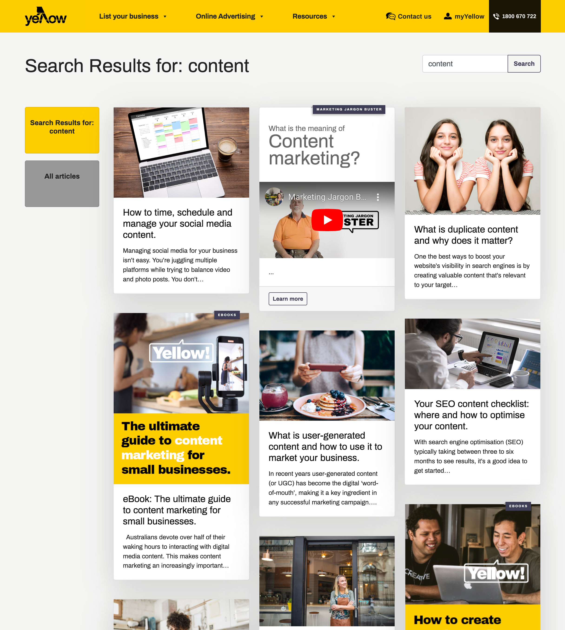
Content Marketing Tools.
Content marketing is not just for marketers. In fact, there are so many free or inexpensive tools available, it’s something that most business owners can undertake without breaking the budget.
Here are just a few of the tools you can utilise when researching, planning and implementing your content marketing strategy:
Keyword/phrase Research tools:
Keyword Generator for finding popular keyword ideas
Answer The Public for finding keywords phrased as questions
ChatGPT for finding seed keyword ideas
Ahrefs Webmaster Tools for finding low-hanging keyword opportunities
Google Keyword Planner for finding related keywords
Google Search Console for finding declining keywords
Google Trends for finding breakout keywords
SERP Checker for analysing a keyword’s traffic potential.
Analytics & Audience Profiling tools:
Google Analytics
Google Trends
Meta Business Suite
Instagram Insights
Facebook Page Insights
Want to know more about how to get content working for your business? Visit Yellow Pages’ Business Hub to find out.

